Slide 1
Minimizing Churn rate Through Analysis of Financial Habits
Meet Shah

Slide 2
Introduction
Subscription Products often are the main source of revenue for companies across all industries. These products can come in the form of a ‘one size fits all’ over compassing subscription, or in multi-level memberships. Regardless of how they structure their memberships, or what industry they are in, companies almost always try to minimize customer churn (a.k.a. subscription cancellations). To retain their customers, these companies first need to identify behavioral patterns that act as a catalyst in disengagement with the product.
Market: The target audience is the entirety of a company’s subscription base. They are the ones companies want to keep.
Product: The subscription products that customers are already enrolled in can provide value that users may not have imagined, or that they may have forgotten.
Goal: The objective of this model is to predict which users are likely to churn, so that the company can focus on re-engaging these users with the product. These efforts can be email reminders about the benefits of the product, especially focusing on the features that are new or that the user has shown to value.

Slide 3

Business Challenge
In this case study we will be working for a fintech company that provides a subscription product to its users, which allows them to manage their bank accounts (saving accounts, credits cards etc.), provides them with personalized coupons, informs them of the latest low-APR loans available in the market and educates them on the best available methods to save money (like videos on saving money on taxes, free courses on financial health etc.).
We are in charge of identifying users who are likely to cancel their subscription so that we can start building new features that the users may be interested in. These features can increase the engagement and interest of the users towards the product.

Slide 4
Data Explanation
By subscribing to the membership, our customers have provided us with data on their finances, as well as how they handle those finances through the product. We also have some demographic information we acquired from them during the sign-up process.
Financial data can often be unreliable and delayed. As a result, companies can sometimes build their marketing models using only demographic data, and data related to finances handled through the product itself. Therefore, we will be restricting ourselves to only using that type of data. Furthermore, product-related data is more indicative of what new features we should be creating as a company.

Slide 5
Visualizations

Slide 6
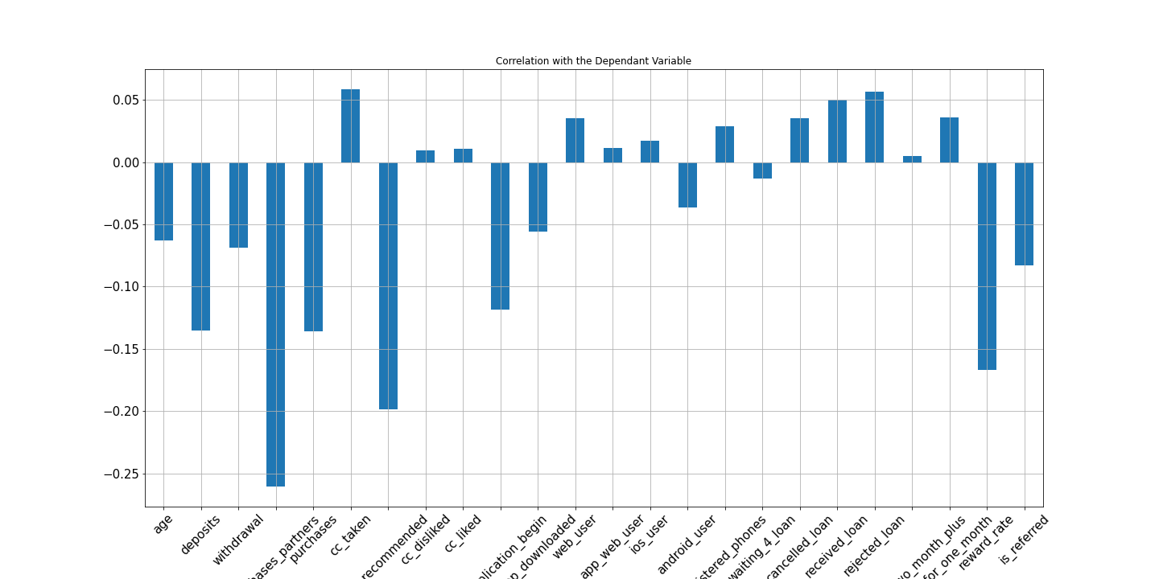
Correlation with the Dependant Variable

Slide 7
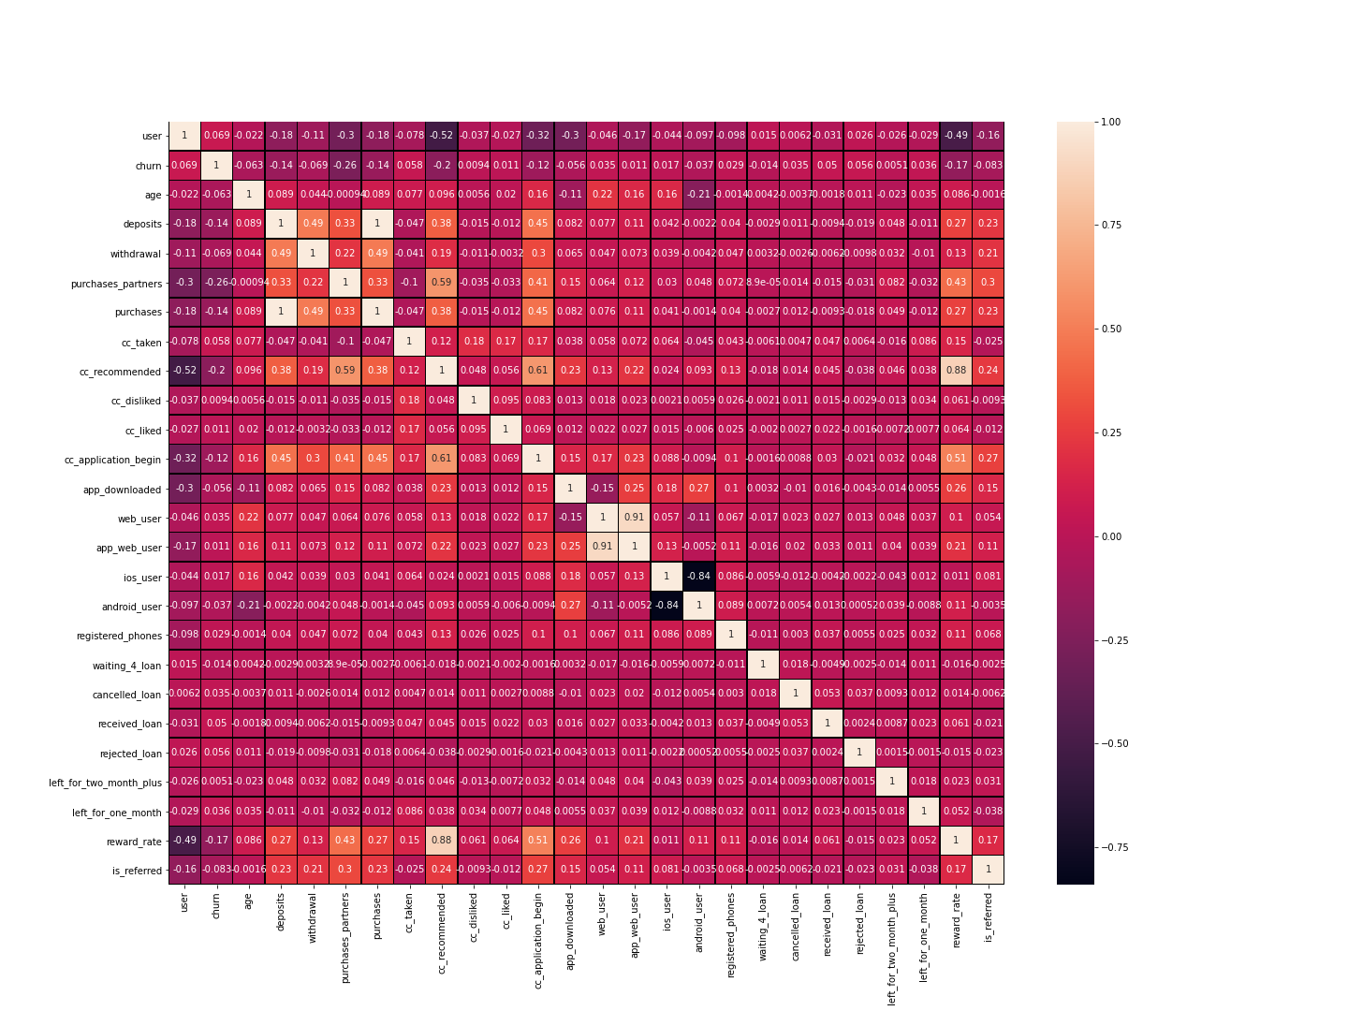
Heatmap showing Correlation of all variables with each other

Slide 8
Model Accuracy

Slide 9
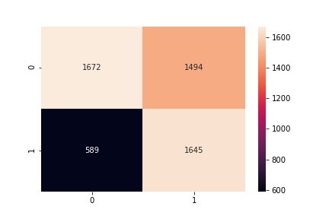
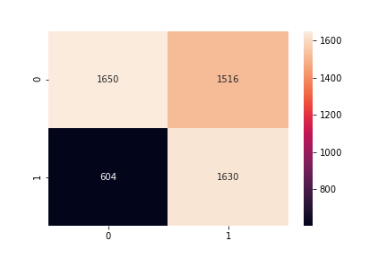
Confusion Matrix Before & After Feature Engineering

Slide 10
Classification Report
 | Precision | Recall | F1-Score
0 | 0.74 | 0.51 | 0.61
1 | 0.52 | 0.74 | 0.61
Average Accuracy | 0.63 | 0.63 | 0.61

Slide 11
Conclusion
Our model has provided us with an indication of which users are likely to churn. We have purposefully left the date of the expected churn open-ended because we are focused on only gauging the features that indicate disengagement with the product, and not the exact manner (like timeframe) in which users will disengage. In this case study we have chosen this open-ended emphasis to get a sense of those who are even just a bit likely to churn because we are not aiming to create new products for people who are going to leave us for sure, but for people who are starting to lose interest in the app.
If, after creating new product features, we start seeing our model predict that less of our users are going to churn, then we can assume our customers are feeling more engaged with what we are offering them. We can move forward with these efforts by inquiring the opinions of our users about our new features (e.g. polls). If we want to transition into predicting churn more accurately, in order to put emphasis strictly on those leaving us, then we can add a time dimension to churn, which would add more accuracy to the model.

